Slide 1


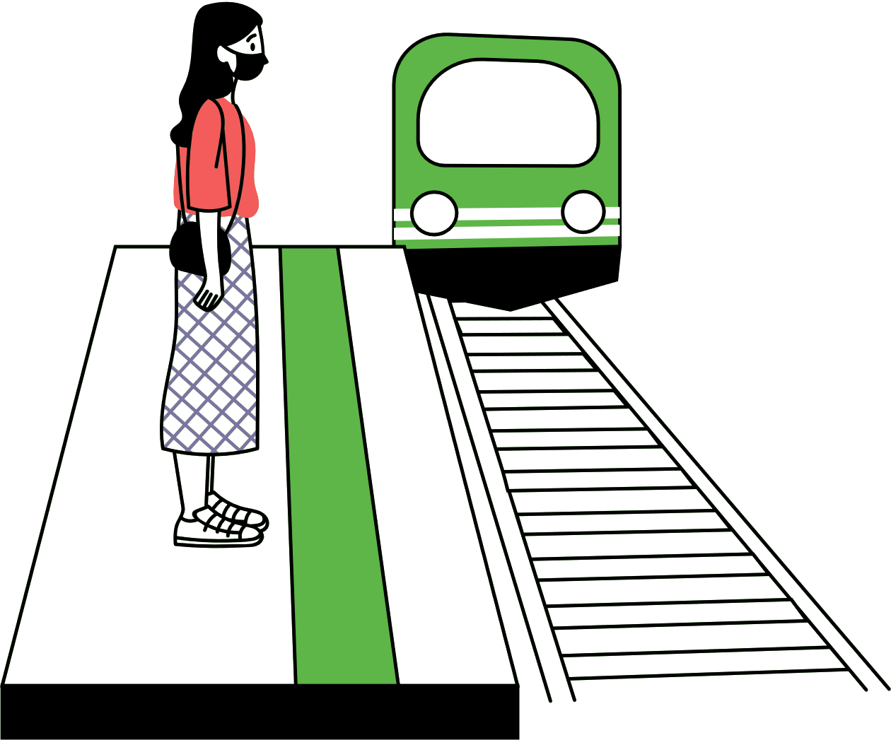
WWW.RAILROAD.COM
01/11
Train Management
System
BRAINY BADGERS
Chugging along the tracks, the distant whistle of the locomotive fills the air, a familiar sound interwoven with memories of bygone eras.

Slide 2




WWW.RAILROAD.COM
05/20
Group Members
Hussain -183
Faizan – 120
Laiba- 071
Ahmad- 096

Slide 3


WWW.RAILROAD.COM
03/11
Table Of Contents
Introduction
Features Offered
.
Details on Services
Conclusion

Slide 4

INTRODUCTION
The purpose of this Project is to make a system for managing train schedules, reservations, and operations efficiently and to build a foundation needed to develop a simple yet effective subway/train management system
Manual train scheduling and reservation systems are prone to errors and inefficiencies, leading to many inconveniences for the passengers
Programming Languages and Tools
JAVA/ JAVA FX

Slide 5

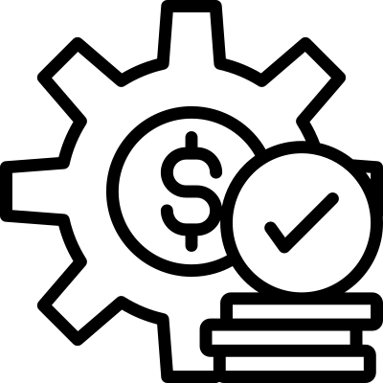
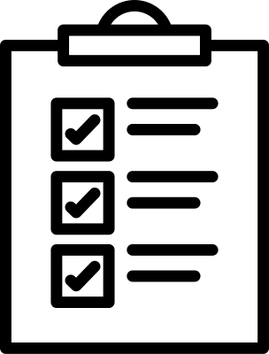


WWW.RAILROAD.COM
05/11
Features Offered
Train Management
Schedule/Route Management
Station Management
Ticket Processing

Slide 6
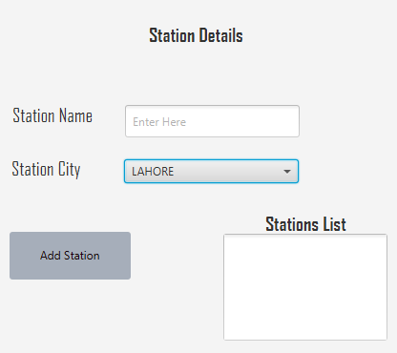
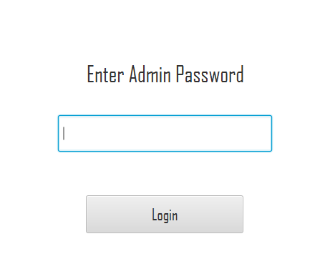
STATION OPERATIONS
Station Management
Add Stations Names
Add Station City
Station List

Slide 7
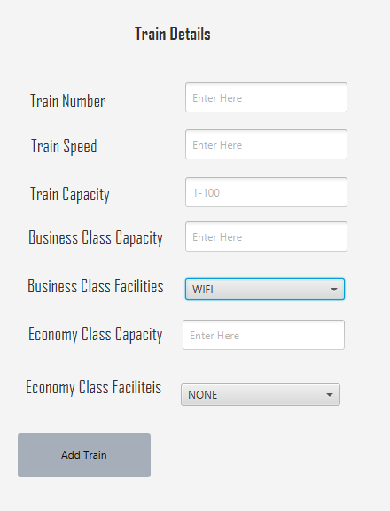
TRAIN MANAGMENT
Edit and Manage Trains
Passenger Capacity
Train Facilities
Train Identification

Slide 8
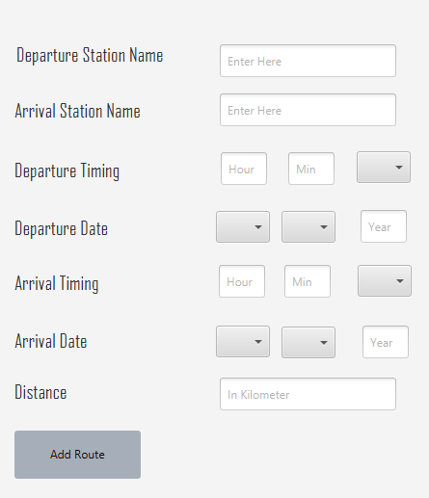
Route Management
Add Departure Timing
Add Arrival Timing
Define Distance

Slide 9
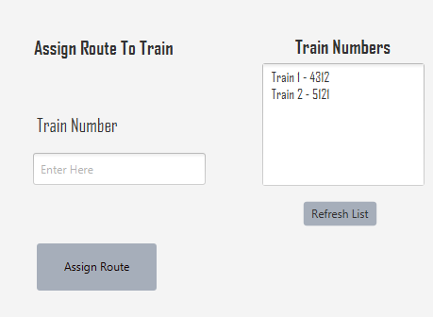
Route Assignment
Train List
Assigns a route to the selected train

Slide 10
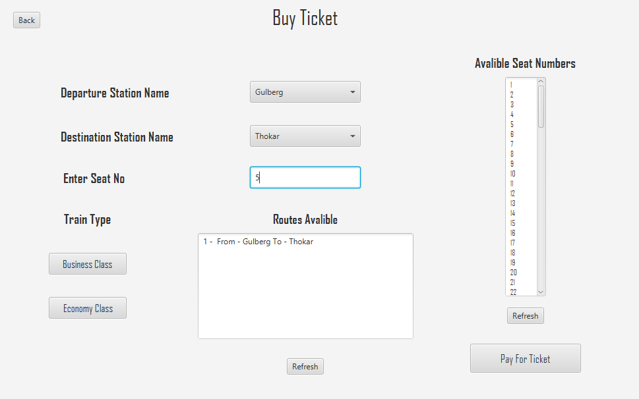
TICKET PROCESSING
Ticket Classes
Price Calculation
Seat Cancelation
Display Routes
Seat Availability Information
Display Ticket Details

Slide 11
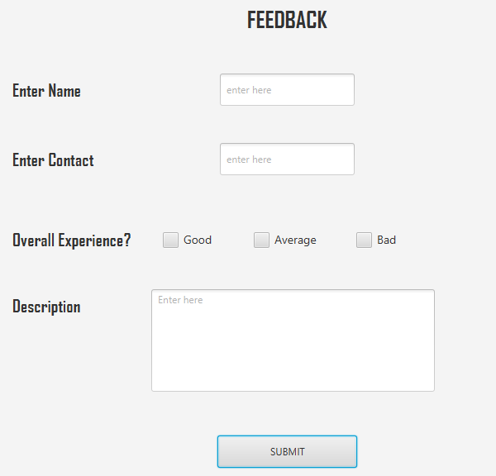
FEEDBACK
Easy Feedback Submission by Passengers
Improvement of Services Based on Passenger Feedback

Slide 12
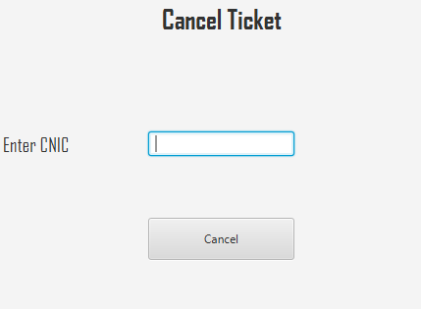
Seat Cancellation
Cancellation of Ticket

Slide 13
CONCLUSION
Our Train/Subway Management System is Built for Simple , Secure and Passenger Friendly Subway Operations
In conclusion, our Train Management System not only addresses the existing challenges, but also lays the groundwork for future improvements, ensuring a more efficient and reliable train service

Slide 14
THANK YOU

